Slide 1
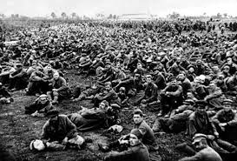
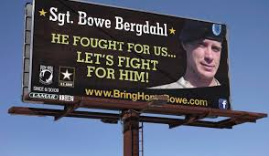
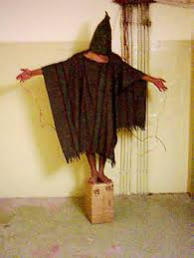
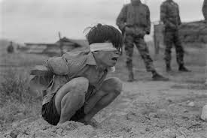

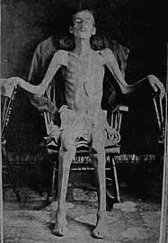
The Dilemmas of Captive Combatants
Paul J. Springer, PhD
Air Command and Staff College
FPRI Senior Fellow

Slide 2
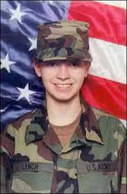
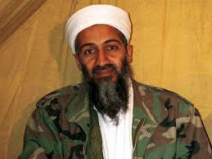
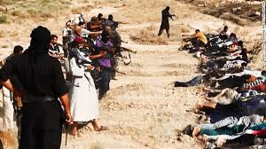
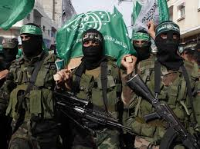
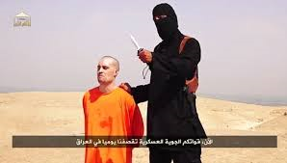
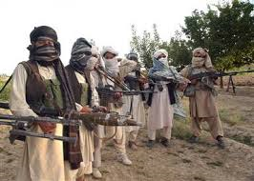
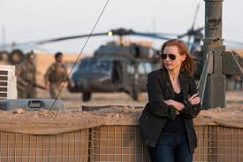
Definitions: Who is a POW?
According to the Geneva Convention Relative to Prisoners of War, 1929,
to be considered a prisoner of war, you must fulfill all of these conditions:
Must be commanded by person responsible for subordinates
Must wear uniform or recognizable symbol
Must carry arms openly
Must conduct operations in accordance with the laws and customs of war

Slide 3
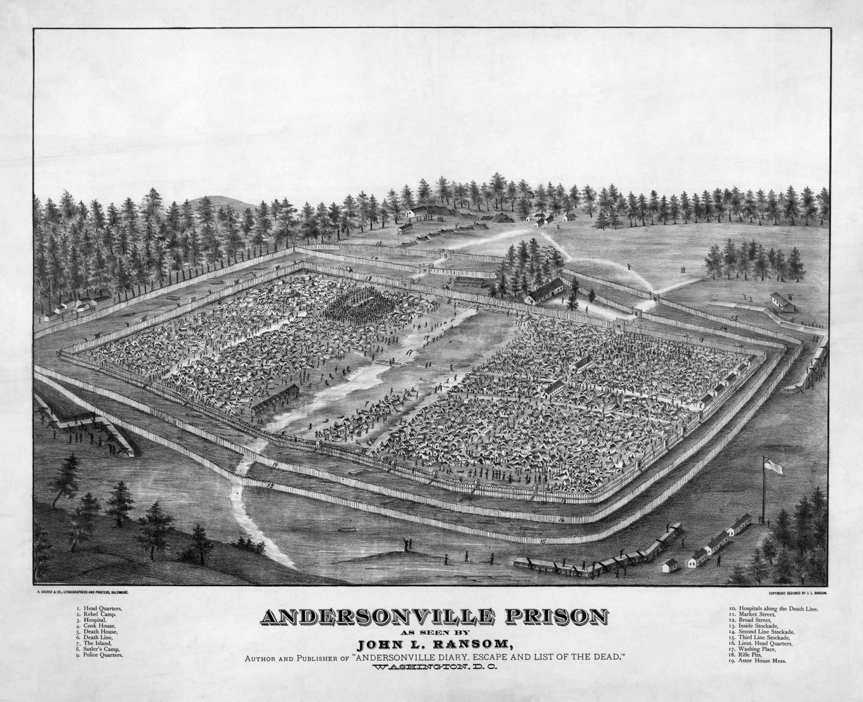
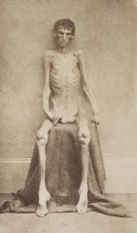
The American Civil War: Unfortunate Wretches

Slide 4
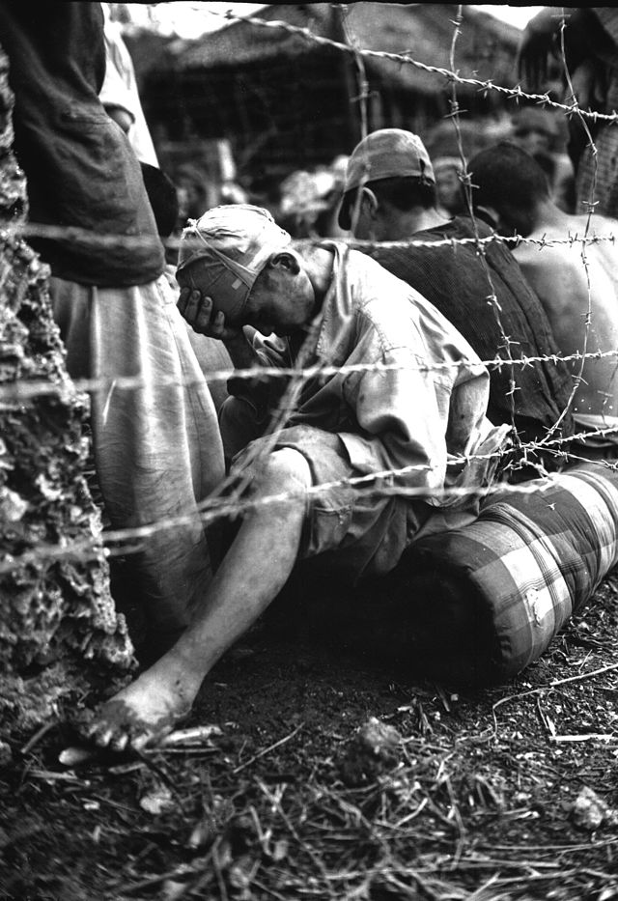
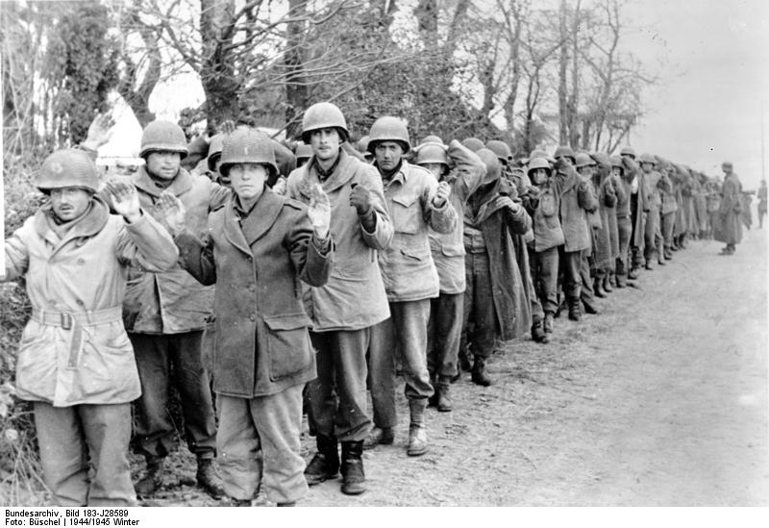
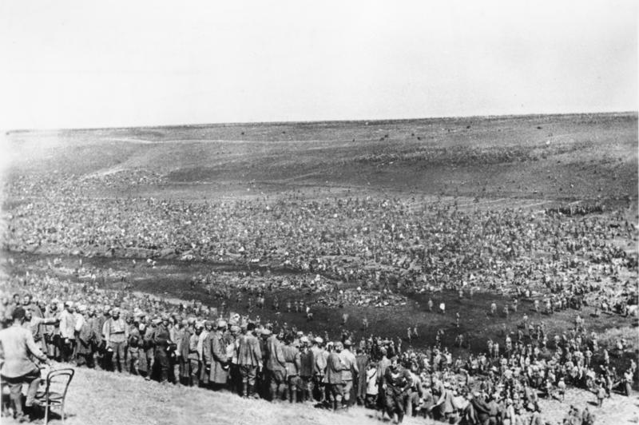
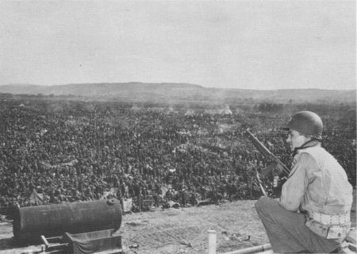
World War II: The Numbers Game

Slide 5
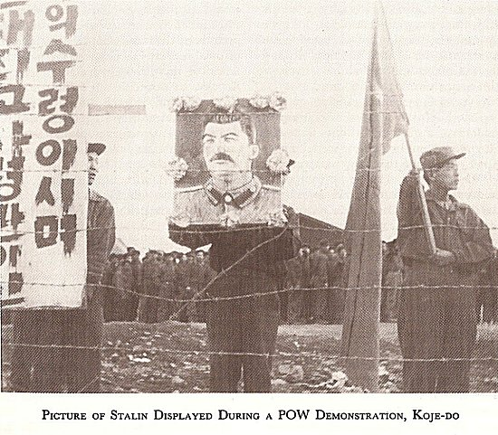
The Korean War: The Fight Continues

Slide 6
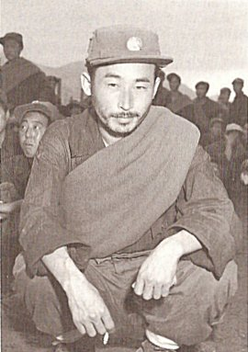
The Korean War: The Fight Continues
Pak Sang Hyong,
Private, North Korean People’s Army
Jeon Moon Il,
Vice Chairman of North Korean Labor Party

Slide 7
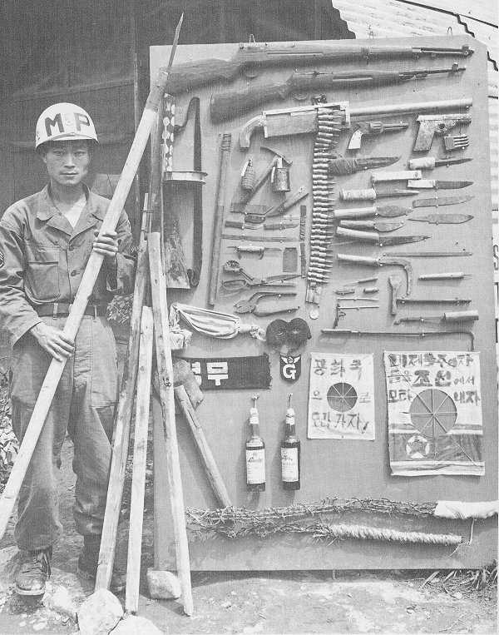
The Korean War: The Fight Continues

Slide 8
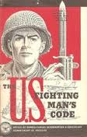
Article I: I am an American, fighting in the armed forces which guard my
country and our way of life. I am prepared to give my life in their defense.
Article II: I will never surrender of my own free will. If in command I will
never surrender the members of my command while they still have the
means to resist.
Article III: If I am captured, I will continue to resist by all means available.
I will make every effort to escape and aid others to escape.
I will accept neither parole nor special favors from the enemy.
Article IV: If I become a prisoner of war, I will keep faith with my fellow
prisoners. I will give no information nor take part in any action which might
be harmful to my comrades. If I am senior, I will take command. If not, I
will obey the lawful orders of those appointed over me and will back them
up in every way.
Article V: When questioned, should I become a prisoner of war, I am
required to give name, rank, service, number, and date of birth. I will
evade answering further questions to the utmost of my ability. I will
make no oral or written statements disloyal to my country and its allies
or harmful to their cause.
Article VI: I will never forget that I am an American, responsible for my
actions, and dedicated to the principles which made my country free. I
will trust in my God and in the United States of America.
(1955)

Slide 9
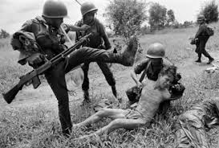
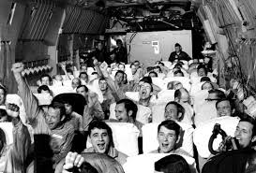

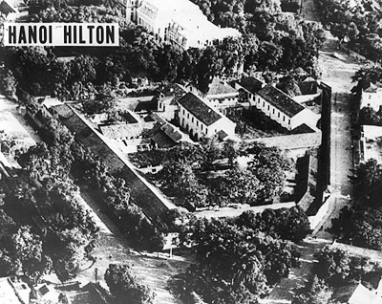
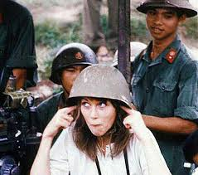
The Vietnam War: Political Pawns

Slide 10
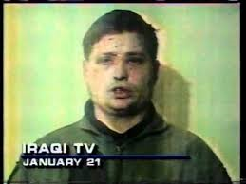
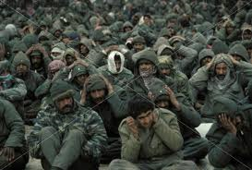
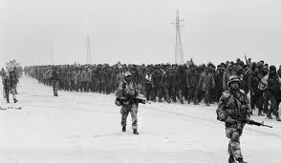
The Gulf War: Human Shields, Human Capital

Slide 11

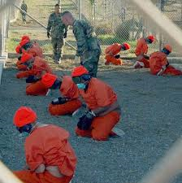
Guantanamo Bay: Are These POWs?

Slide 12
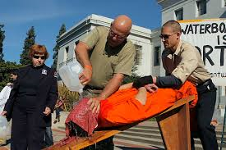
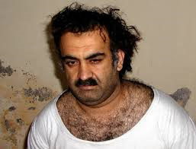
Guantanamo Bay: Are These POWs?
Note: This is a protestor doing a
waterboarding demonstration, not an
actual waterboarding session.

Slide 13
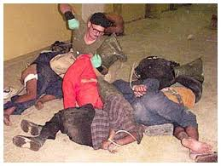
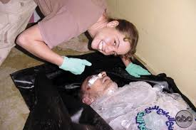
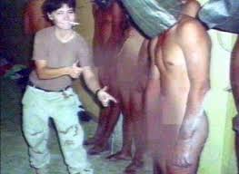
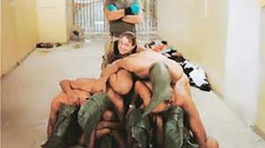
Abu Ghraib: Getting Everything Wrong

Slide 14
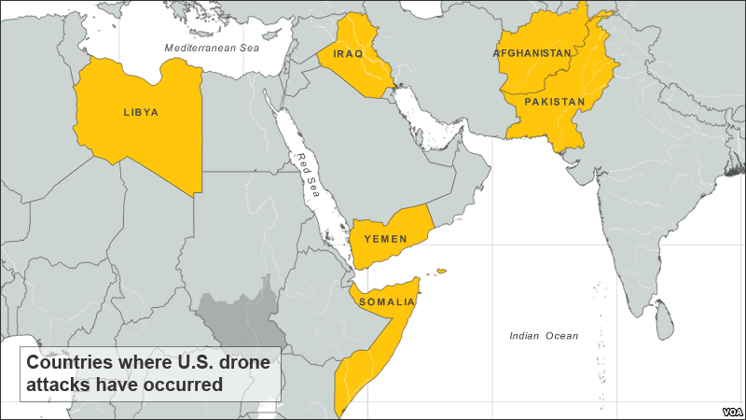

Slide 15
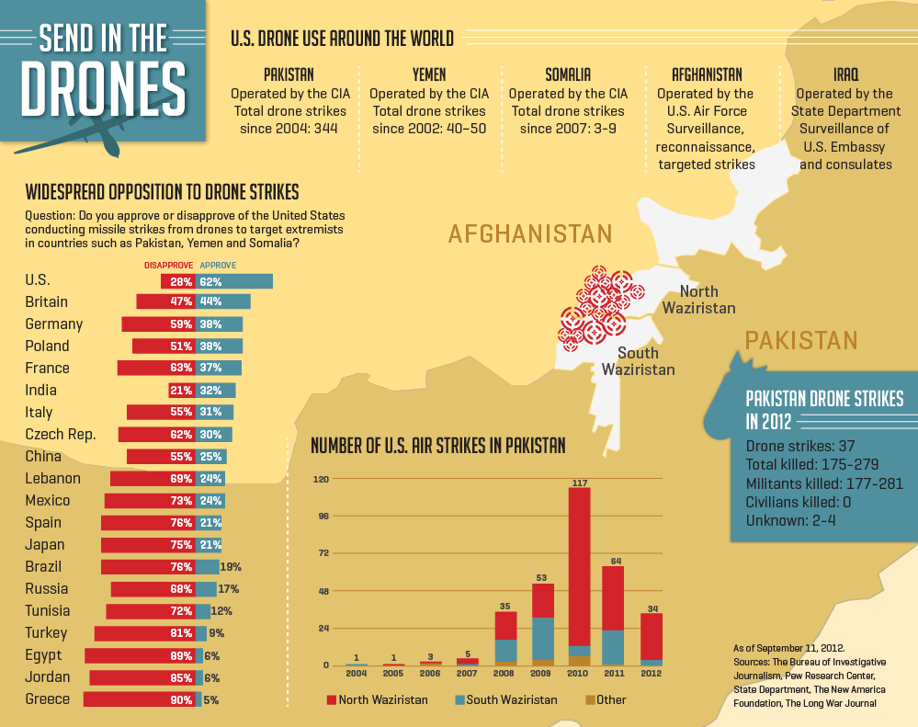

Slide 16
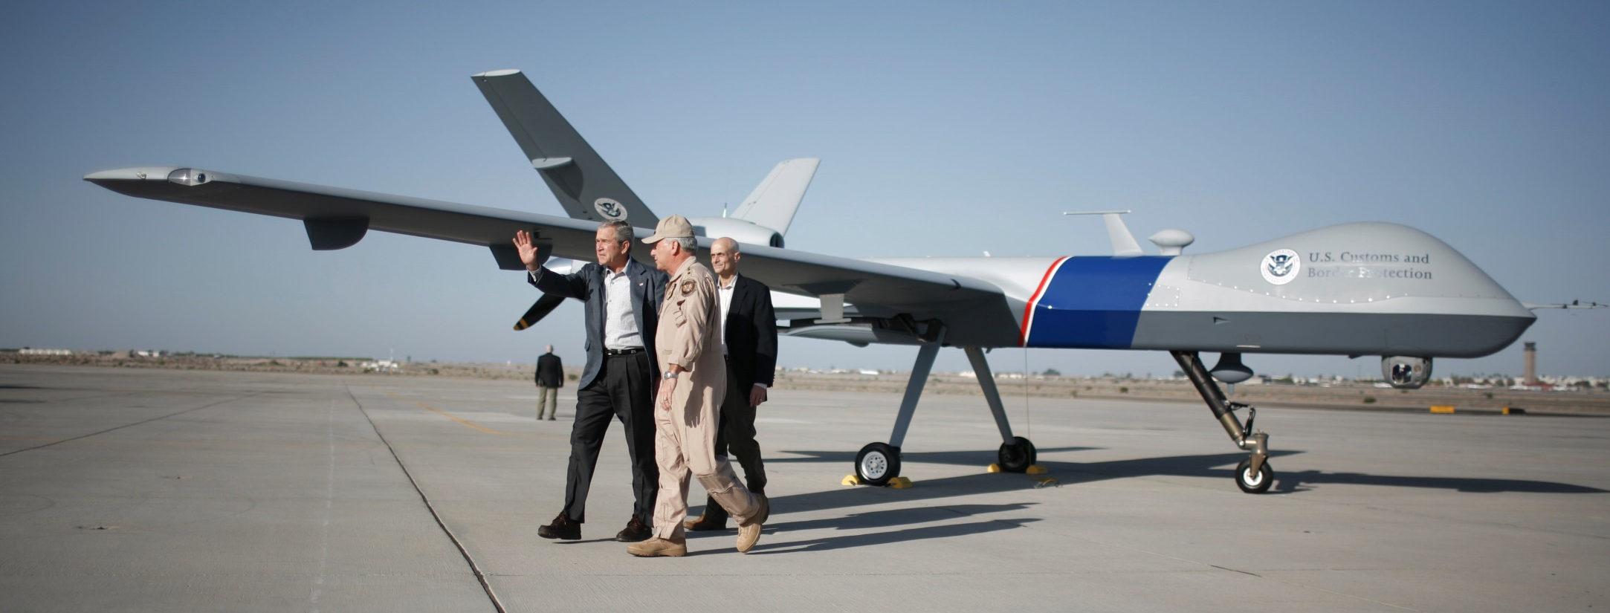
The Bush Years – PAKISTAN (FATA) 2004-2009
Total CIA drone strikes | 51
Total reported killed: | 410-595
Civilians reported killed: | 167-332
Children reported killed: | 102-129
Total reported injured: | 175-277

Slide 17
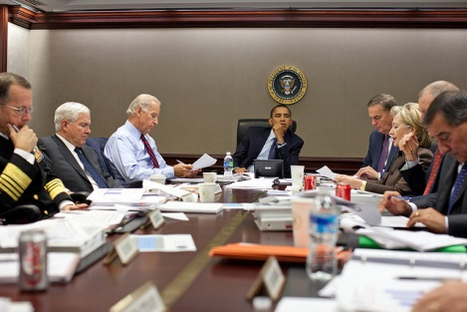

Slide 18
CIA strikes – PAKISTAN (FATA) 2009
Total CIA drone strikes | 52
Total reported killed: | 465-744
Civilians reported killed: | 100-210
Children reported killed: | 36-39
Total reported injured: | 262-397
CIA strikes – PAKISTAN (FATA) 2010
Total CIA drone strikes | 128
Total reported killed: | 751-1,109
Civilians reported killed: | 84-196
Children reported killed: | 19-20
Total reported injured: | 351-428
CIA strike – PAKISTAN (FATA) 2011
Total CIA drone strikes | 75
Total reported killed: | 363-666
Civilians reported killed: | 52-152
Children reported killed: | 6-11
Total reported injured: | 158-236

Slide 19
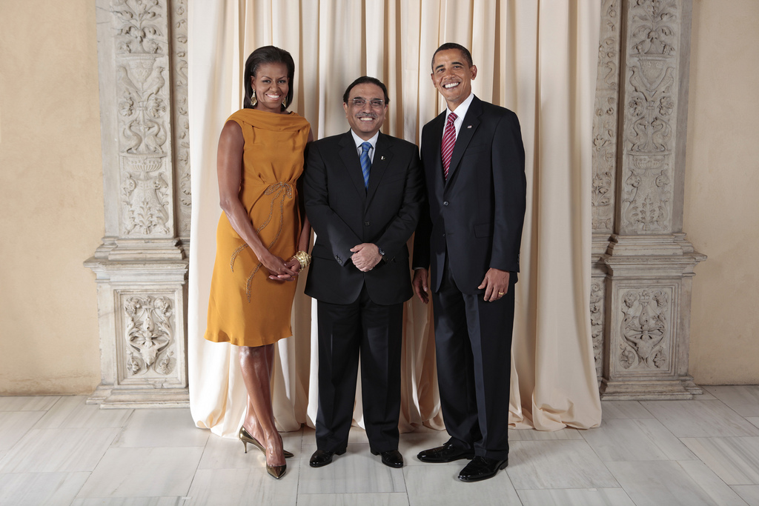

Slide 20
CIA strikes – PAKISTAN (FATA) 2012
Total CIA drone strikes | 50
Total reported killed: | 199-410
Civilians reported killed: | 13-63
Children reported killed: | 1-2
Total reported injured: | 100-212
CIA strikes – PAKISTAN (FATA) 2013
Total CIA drone strikes | 27
Total reported killed: | 109-195
Civilians reported killed: | 0-4
Children reported killed: | 0-1
Total reported injured: | 43-89
CIA strikes – PAKISTAN (FATA) 2014
Total CIA drone strikes | 25
Total reported killed: | 115-186
Civilians reported killed: | 0-2
Children reported killed: | 0-2
Total reported injured: | 53-76

Slide 21
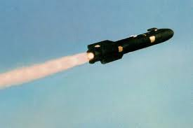
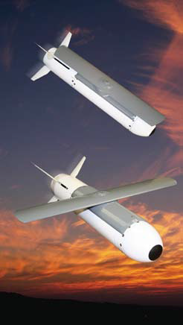
Hellfire vs. Scorpion
 | HELLFIRE | SCORPION
LENGTH | 64 INCHES | 21.5 INCHES
DIAMETER | 7 INCHES | 4.25 INCHES
WEIGHT | 110 POUNDS | 35 POUNDS
WARHEAD SIZE | ~20 POUNDS | 5-17 POUNDS
RANGE | UP TO 5 MILES | UP TO 10 MILES
UNIT COST | ~$110,000 | ~$25,000

Slide 22
CIA strikes – PAKISTAN (FATA) 2015
Total CIA drone strikes | 5
Total reported killed: | 26-38
Civilians reported killed: | 0
Children reported killed: | 0
Total reported injured: | 9-14
Reported US strikes, Afghanistan 2015
 | Confirmed US strikes | Possible US strikes | Total Likely US Strikes
Total reported strikes: | 5 | 3 | 8
Total reported killed: | 35-44 | 12 | 47-56
Civilians reported killed: | 0 | 0-1 | 0-1
Children reported killed: | 0 | 0-1 | 0-1
Total reported injured: | 0 | 3 | 3

Slide 23
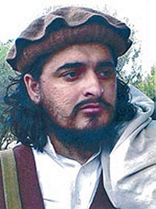
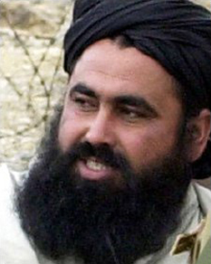
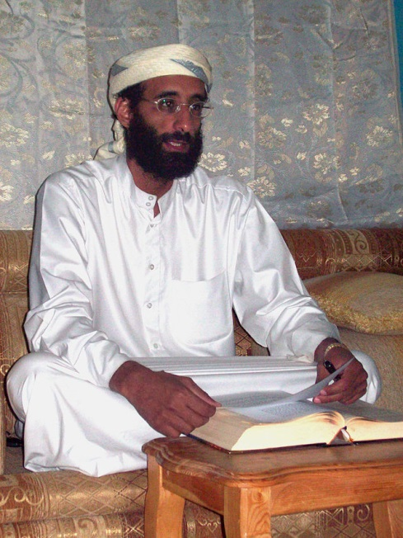
Osama bin Laden
(KIA 2 May 2011)
Hakimullah Mehsud
(KIA 1 November 2013)
Baitullah Mehsud
(KIA 5 August 2009)
Anwar al-Awlaki
(KIA 30 September 2011)

Slide 24
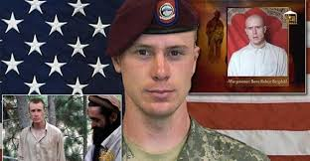
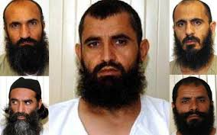
Bowe Bergdahl: Traitor or POW?

Slide 25
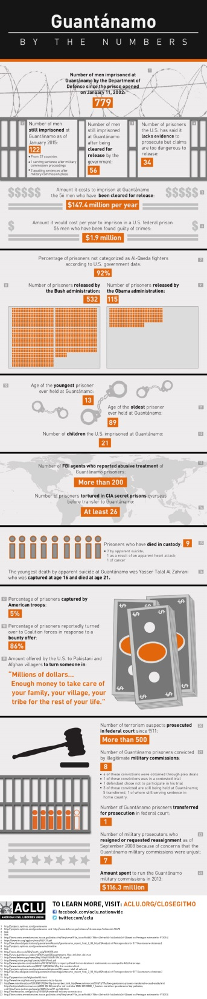
Have We Left the POW Business?
(Graphics courtesy of American Civil Liberties Union)

Slide 26
The Dilemmas of Captive Combatants
Paul J. Springer, PhD
Air Command and Staff College
FPRI Senior Fellow

