Slide 1

TEACHING ABOUT ISRAEL AND PALESTINE
A History Institute for Teachers
Hotel Palomar, 117 S 17th St, Philadelphia, PA 19103
October 25-26, 2014

Slide 2
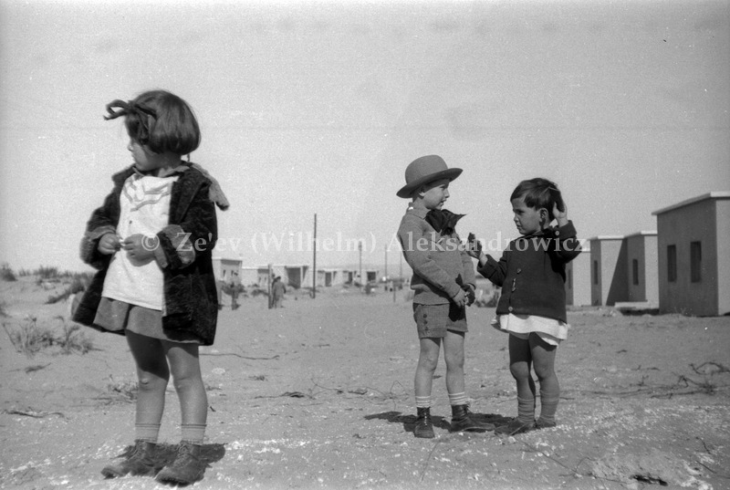
The Origins and Evolution of Zionism
Prof. Liora R. Halperin
University of Colorado Boulder

Slide 3
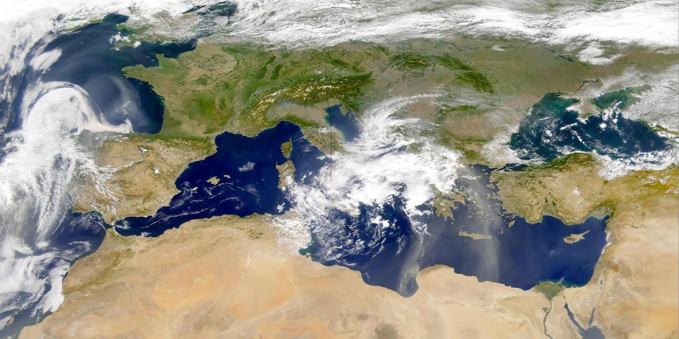
A transnational story
\

Slide 4
Zionism: A political and cultural movement that emerged in late 19th century Europe and developed further in Palestine, that held that:
Jews constituted a national group (not only a religion)
Jews should be recognized and given political rights, national autonomy, or sovereignty on the basis of this national status.
The location in which Jews should get this autonomy and/or sovereignty should be Palestine (which Jews called the Land of Israel: Zion is a biblical term for Jerusalem).*

Slide 5
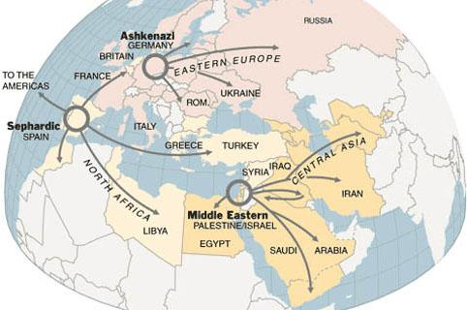
The Jewish World
Ashkenazi (“German”) Jews:
From Russia, Poland, Germany
Sephardi (“Spanish”) Jews: Jews displaced from Spain in 1492. From Turkey, North Africa, Greece, etc.
Mizrahi (“Eastern”) Jews:
From Palestine, Iraq, Syria, Egypt, Iran

Slide 6
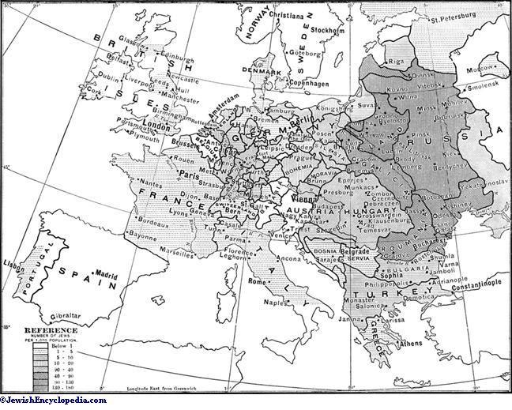
Location of European Jews, late 19th century

Slide 7
Trends in Eastern Europe
(Russian Empire)
Trends in Western and Central Europe
(esp. Germany, Austria)

Slide 8
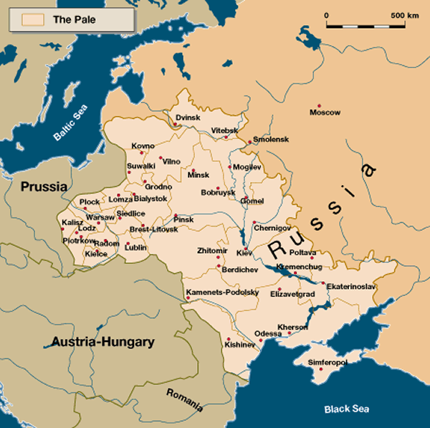
The Pale of Settlement 1880s-1900s:
Rapid developments in Ashkenazi Jewish Politics

Slide 9
Eastern Europe:
Modernization and Ethnic Nationalism
State Centralization (without emancipation)
Modernization movements; emergence of “Maskilim,” enlightened Jews
Growing Antisemitism, esp. after 1882
Turn to Jewish nationalism, esp. ethnic / linguistic nationalism (including Zionism)

Slide 10
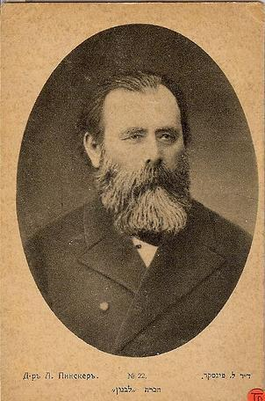
Leon Pinsker, Auto-Emancipation, 1882
“The great ideas of the eighteenth and nineteenth centuries have not passed us by without leaving a trace. We feel not only as Jews; we feel as men. As men, we, too, wish to live and be a nation as the others. And if we seriously desire that, we must first of all extricate ourselves from the old yoke, and rise manfully to our full height. We must first of all desire to help ourselves and then the help of others is sure to follow.”

Slide 11
Western and Central Europe:
Crisis of enlightenment
Enlightenment and Emancipation. Jews become part of nations where they lived.
Can / should Jews really be integrated? (“The Jewish Question”)
Growing Antisemitism
Turn to Jewish nationalism (by some)

Slide 12
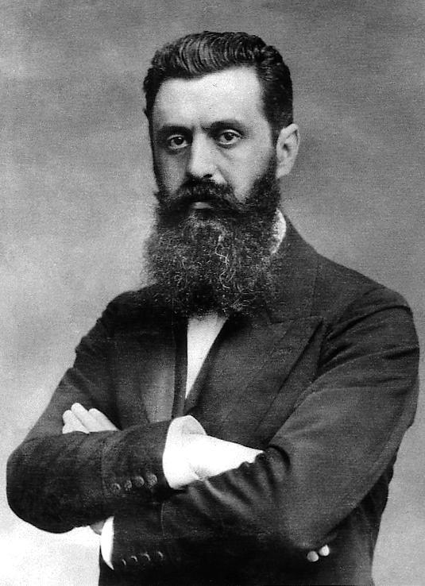
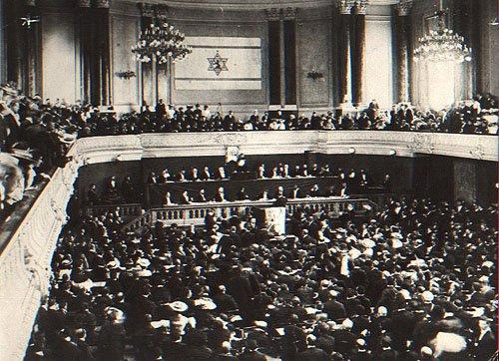
Theodor Herzl: Zionism as a Solution to Antisemitism.
“The Jewish Question still exists, it would be foolish to deny it. It exists wherever Jews live in perceptible numbers. Where it does not yet exist, it will be brought by Jews in the course of their migrations.”
“Let the sovereignty be granted us over the portion of the globe large enough to satisfy the requirements of the nation--the rest we shall manage for ourselves.”
Source: Herzl, the Jewish State (1896)

Slide 13
Widespread Jewish opposition
to Zionism
Orthodox Jews: Zionism is heresy
Liberal Jews:
Zionism will threaten Jewish progress toward integration
Autonomists:
Demand Jewish national rights here, where we are
Socialist Jews: Zionism (like all nationalism) is bourgeois

Slide 14
Evolution of Zionism
Zionism as a means of asserting Jewish national identity in Europe (and beyond)
Zionism as a settlement project to create a Jewish homeland in Palestine

Slide 15
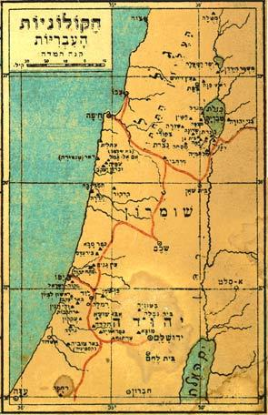
Zionist Immigration to Palestine
(Jews called it Aliyah--“ascent”)
“1st” Aliyah 1882-1903
European-supported
colonies (moshavot)
“2nd” Aliyah 1904-1914
“3rd” Aliyah 1917-1923

Slide 16
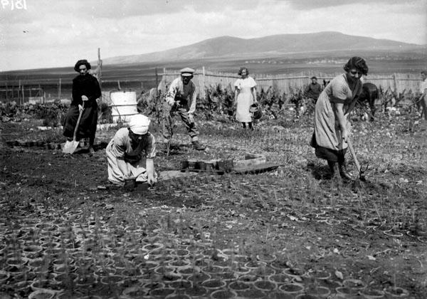
Zionist Immigration to Palestine (aliyah)
1st Aliyah 1882-1903
2nd Aliyah 1904-1914
and
3rd Aliyah 1917-1923
Idea of “Conquest of Labor”
Formation of the Kibbutz
Emergence of Labor Zionism

Slide 17
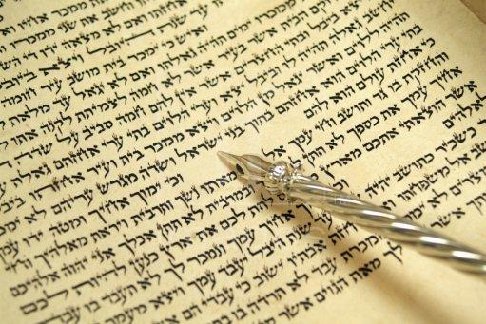
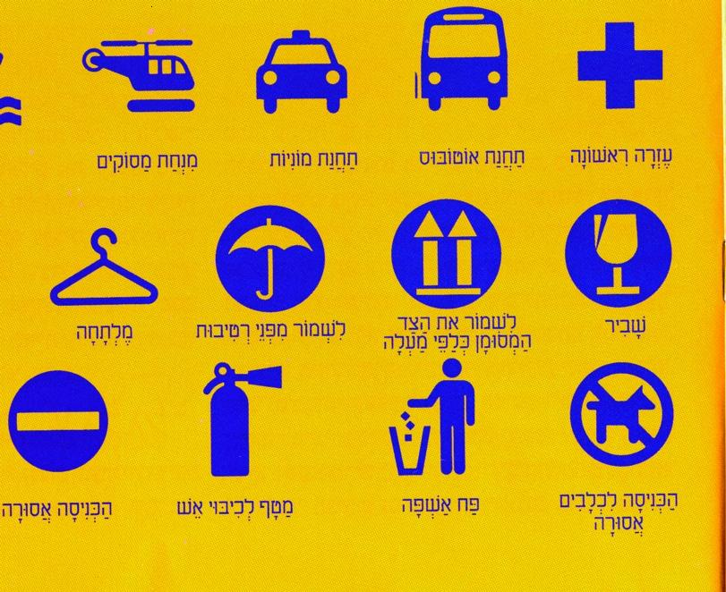
Cultural Zionism and Hebrew promotion
From a sacred language…
...to modern Hebrew

Slide 18
Religious Zionism
Reconcile Orthodoxy with Zionism
Settling the land as the first step towards the bringing of the messianic age.
A small movement early on….
After 1967 it becomes a major political force.

Slide 19
Imperial Influence
Ottoman
Tanzimat reforms
Land regulations
British
Imperial ambitions lead to the
Balfour Declaration

Slide 20
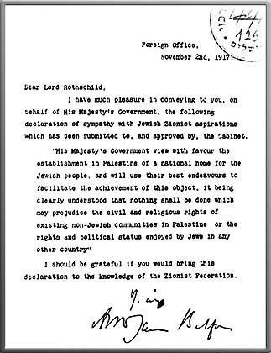
Source:
The Balfour Declaration, 1917
“His Majesty's government view with favour the establishment in Palestine of a national home for the Jewish people, and will use their best endeavours to facilitate the achievement of this object, it being clearly understood that nothing shall be done which may prejudice the civil and religious rights of existing non-Jewish communities in Palestine, or the rights and political status enjoyed by Jews in any other country.”

Slide 21

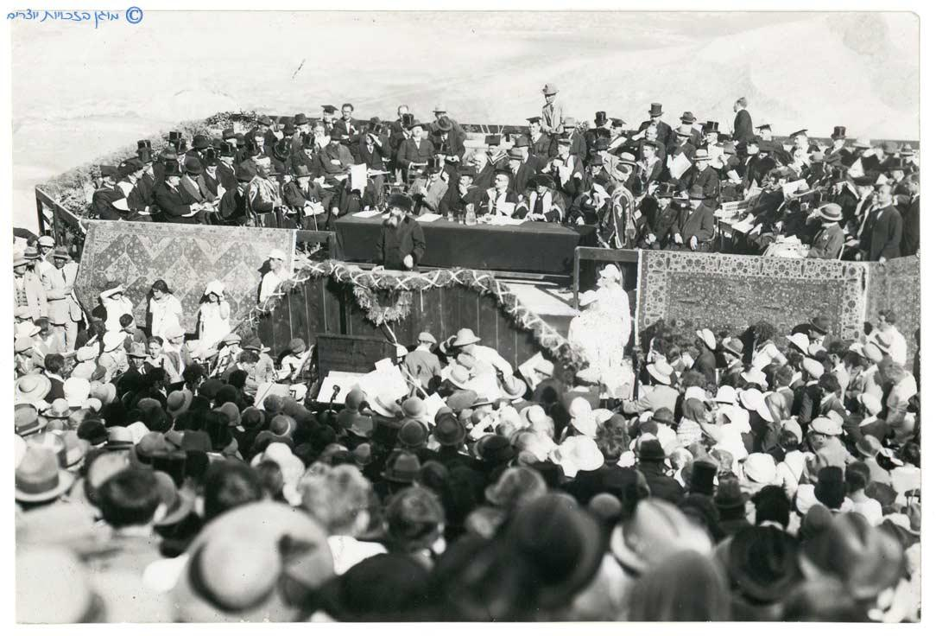
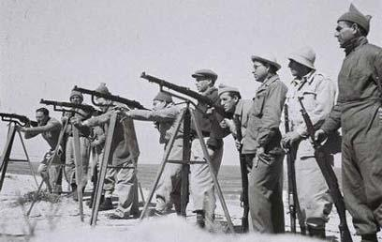
The Mandate Period: Institutional and Cultural Developments

Slide 22
The “Arab Question” becomes a central Jewish Question
Didn’t think about it.
Zionists should hire locals, things will be fine
Earlier
OR
Labor Zionists
(Zionist left wing)
Arabs don’t understand that Zionists have good intentions, but can be convinced.
Revisionists
(Zionist right wing)
Conflict is inevitable; Zionists should plan to win.
Source: Vladimir Jabotinsky, “Ethics of the Iron Wall”
By the 1920s

Slide 23
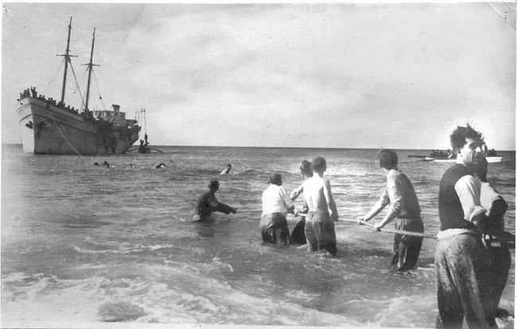
Beyond ideology:
Palestine as a practical choice
1923-1929 -- “4th” Aliyah, economic migrants
1933-1939 -- “5th” Aliyah, refugees from Hitler
1939 -- British “White Paper,” illegal immigration
1939-1945, The Trauma
of the Holocaust

Slide 24
Coming Full Circle:
Debates about Zionism as debates about Jewish modernity

